Slide 1



Slide 2
Q-SNAKE Portable
FEATURES
GOALS
Reduced version of the game to run in a Pew-Pew.
Each apple location is generated randomly with measurements on a qubit with qiskit (aether).
Simple barrier which the snake can tunnel or crash with some probability.
Programming a fun game to play!
Creating a very simple game to introduce Quantum Computing and programming to high school students.
Introduce quantum concepts to students (tunneling, superposition…)

Slide 3
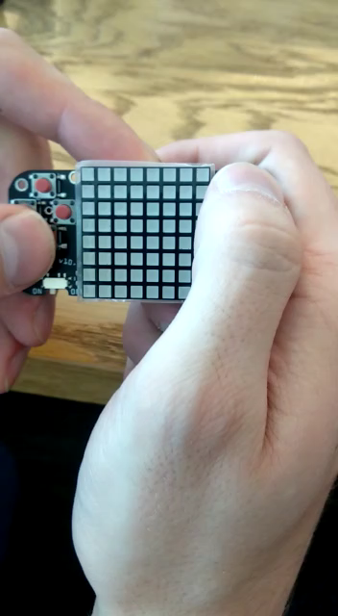
Demo

Slide 4
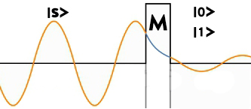
Q-SNAKE Plus+
RULES AND MECHANISMS
ENERGY = TUNNELING PROB
SEGMENT-WISE TUNNELING
HEAD MUST TUNNEL ALWAYS

Slide 5
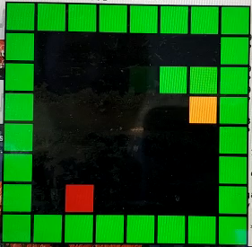

Slide 6
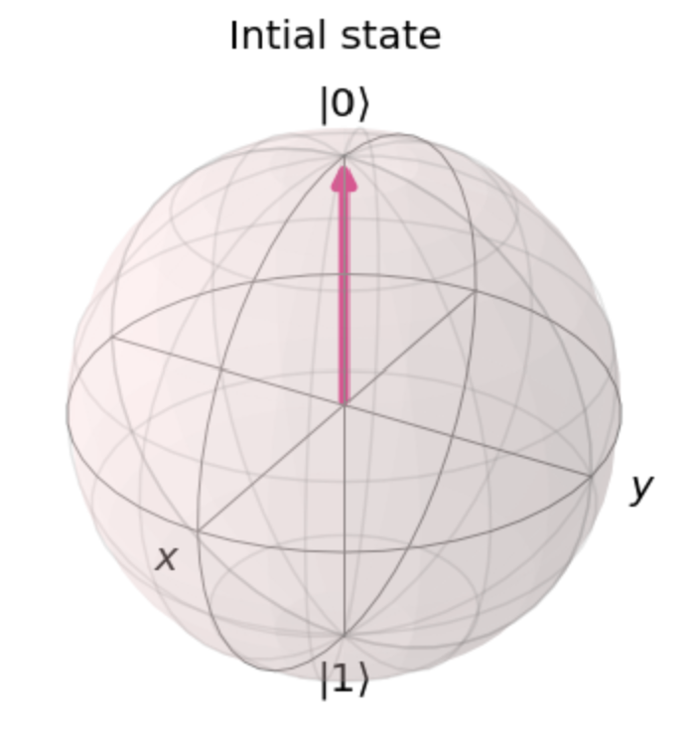
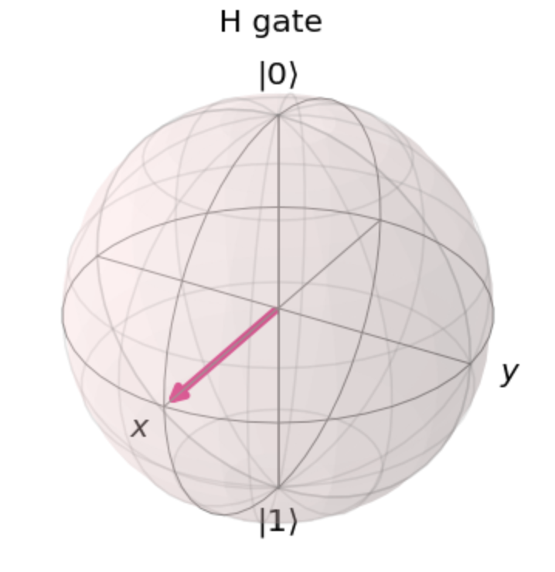
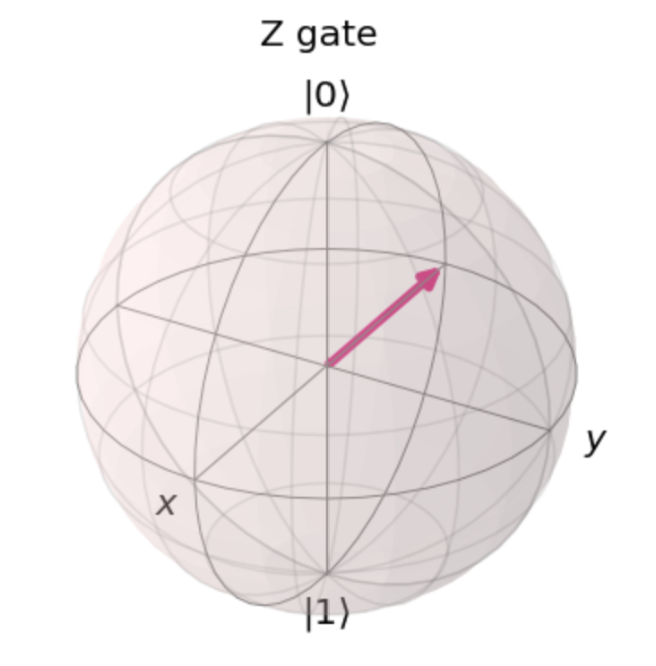
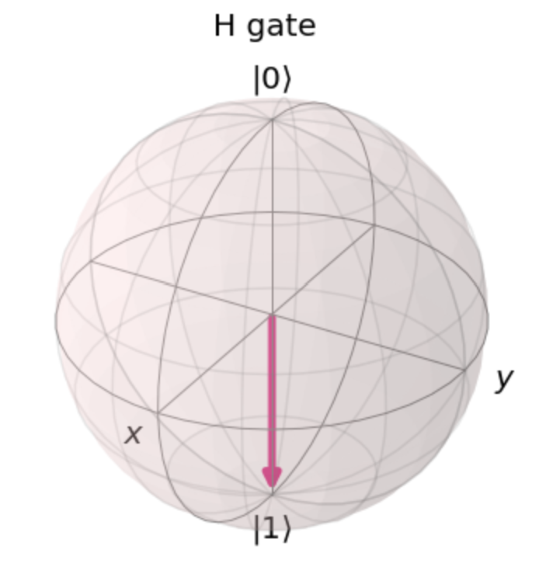
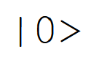
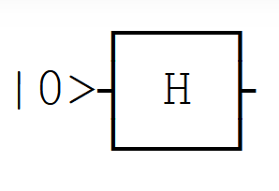
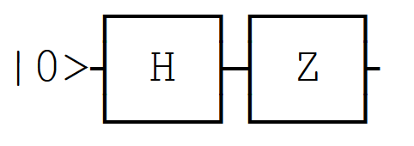
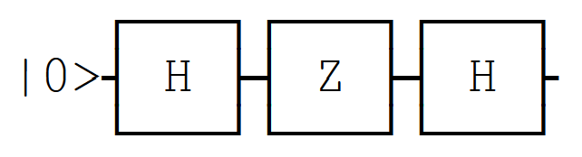
Q-SNAKE Circuit
RULES AND MECHANISMS
RULES AND MECHANISMS:
SNAKE = STATE
APPLE = GATE
ERROR PIXEL = QUANTUM ERROR

Slide 7
